Slide 1

Fundamentals of Politics Research Lecture 1 (2020-21) Introduction: studying politics at university Dr Adrian Blau* * My surname rhymes with ‘flaw’.

Slide 2
Mindset: key questions
Do I trust the data? Do I trust these intuitions?
How can I test these claims, e.g. objections, counter-examples, or other interpretations?
Am I or these authors trapped by theories?
How confident am I in these findings? How firmly should I present my conclusions? How generalisable are these claims?
Are we even asking all the right questions in the first place?
In essays too!

Slide 3
Today
1. Studying politics at university | 7. Facts and values
2. Questions | 8. Him and hers
3. Answers | 9. Subject and object
4. A science of politics? | 10. Concepts
5. Quantitative and qualitative | 11. Bullshit
6. Reading week | 12. Recap: ethical scholarship
asdasdasd
Overview

Slide 4
1: Look for what’s good and bad in everything you read.
Passive (taking notes), active (evaluating).
Am I qualified to criticise Plato? Yes!
Am I qualified to criticise professors/‘facts’? Yes!
‘Dare to be wise’ (Kant). We will empower you.
A balance of arrogance, humility, intelligence, and knowledge. Can take time to get this.
We expect you to (politely, intelligently) criticise parts of the literature in essays and exams.

Slide 5
2: Don’t be too trusting – it could be a trap!
Gadamer, Truth and Method (1960).
Rational choice theory assumes self-interest (e.g. Risse 2000, 3).
Not necessarily (e.g. Tsebelis 1990, 21).
Everything you read is a claim. Every claim is questionable, maybe wrong.
Read widely. School/university: one/many things.

Slide 6
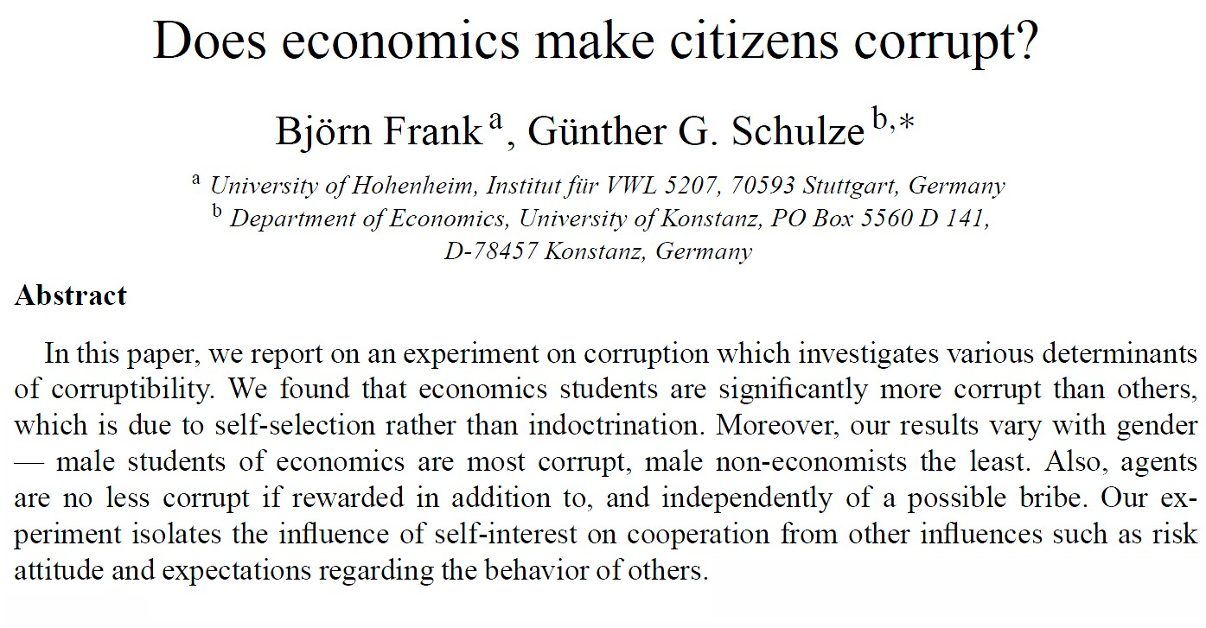
3: Think like a researcher, not just like a student
Answers/questions.

Slide 7
Writing like a student: example
‘Frank and Schulze (2000) ran an experiment which shows that economics students are significantly more corrupt than non-economics students. The authors controlled for the possibility that this was because of teaching, and showed that self-selection was the cause.’

Slide 8
Writing like a researcher: example
‘Frank and Schulze (2000) ran an experiment which suggests that economics students were significantly more corrupt than non-economics students. However, it is not clear how generalisable the experiment is, as it was run only on German students.’
Does not have as much substantive information.
You do not need to give answers to think like a researcher.

Slide 9
Exercise 1
William Niskanen, book review of Susan Rose-Ackerman, The Political Economy of Corruption:
‘Our ideal should be good government, measured in terms of the shared values of the whole population, not democratic government. … The use of money in politics and the distinction between legal and illegal uses should be judged in terms of the same shared values that are the basis for good government.’

Slide 10
Summary so far
Look for what’s good and bad in everything you read.
Don’t be too trusting – it could be a trap!
Think like a researcher, not just like a student.

Slide 11
4: Think sophisticatedly
Not necessarily an advantage to have studied politics at school.
Before university we mostly learn how to discuss politics from journalists and politicians.
Use the language, ideas and mindset of a (good) social scientist or political theorist.

Slide 12
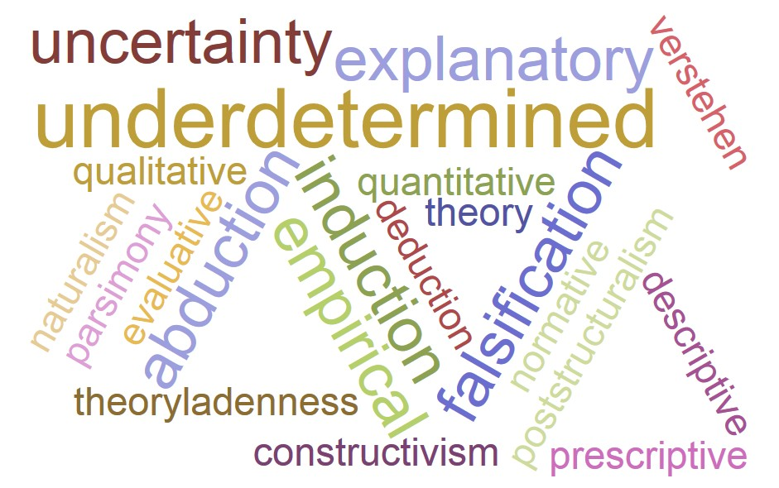
Language

Slide 13
5: Aim high
Don’t necessarily go for the most obvious answer.
What argument will give you a good mark?
Aiming high can be risky. If in doubt: check with convenor/TA.
Pushing yourself is an incredibly important part of university education.

Slide 14
6: It’s how hard you think, not just how hard you work.
Number of hours in the library?
Try to get the balance right!

Slide 15
7: There are no definite answers: the process is key.
‘I couldn’t see the answer in the books.’
Reasoned analysis and justification – how you think your way through a problem.
For essays, we’re more interested in how you argue than what you argue.
If you do see an answer, look for or think of a different one.
The process is usually dialectical, not one-sided.

Slide 16
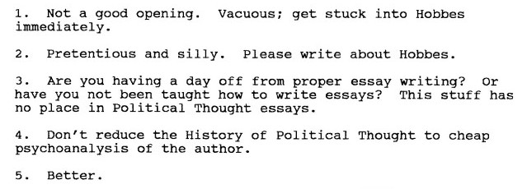
8: Learn from criticism

Slide 17
8: Learn from criticism
Criticism is the name of the game.
Even if you think the criticism is unjustified, think: can I avoid this next time?
Four dangerous frames of mind:
‘I don’t really care, I’m happy at this level.’
‘This is my level, I can’t get any better.’
‘They’re wrong.’ Play the game.
Forgetfulness – of praise or criticisms!

Slide 18
Summary
Look for what’s good & bad in everything you read.
Don’t be too trusting – it could be a trap!
Think like a researcher, not just like a student.
Think sophisticatedly.
Aim high.
It’s how hard you think, not just how hard you work.
There are no definite answers: the process is key.
Learn from criticism.
Never just read out what’s on the screen.

Slide 19
Conclusion
You are your own educators.
Develop the mindset – and use the language – of an active, critical, sophisticated researcher.
It can take time to develop these skills.

Slide 20
(References)
Frank, Björn, and Günther Schulze. 2000. Does economics make citizens corrupt?, Journal of Economic Behavior & Organization 43:1, 101-13.
Gadamer, Hans-Georg. 2004. Truth and Method, tr. Joel Weinsheimer and Donald Marshall. 2nd edition. London: Continuum.
Risse, Thomas. 2000. ‘Let’s Argue!’: Communicative action in world politics. International Organization 54:1, 1-39.
Tsebelis, George. 1990. Nested Games: Rational Choice in Comparative Politics. Berkeley: University of California Press.

